Slide 1
Introduction to Future Technology Transformations FTT – Part (2)
Pim Vercoulen ピムバクレン
p.vercoulen@student.ru.nl
June 3rd, 2018 ASSIA office Nagoya University 名古屋大学

Slide 2
Outline for today
Recap of last FTT:Seminar
FTT:Steel
Preliminary results on China, Japan, Korea, and Taiwan
The data that is still sought for
FTT:Power
Working with the varying policies
Subsidy + demand policies
Exogenous capacity additions (e.g. government enforced) + Regulations
Carbon tax + Feed-in-Tariff

Slide 3
Recap of last week
$LC\left(t\right)=P=$ $\frac{\sum_{0}^{τ}{\frac{IC\left(t\right)+OM\left(t\right)+FC\left(t\right)+CO2T\left(t\right)+…}{{\left(1+r\right)}^{t}}}}{\sum_{0}^{τ}{\frac{1}{{\left(1+r\right)}^{t}}}}$
$$F_{i→j}=\frac{1}{2}+\frac{1}{2}∗\frac{2}{\sqrt{π}}\int{e^{{−\left(\frac{{LC}_{j}−{LC}_{i}}{{sdF}_{ij}}\right)}^{2}}}$$
$$\sum_{j}{∆S_{j→i}}={∆S}_{i}=\sum_{j}{S_{i}S_{j}∙\left(F_{ij}A_{ij}−F_{ji}A_{ji}\right)∙∆t}$$
Methodology of FTT framework
Levelised cost
Preference Matrix
Change in market share
Preliminary Results of FTT:Steel
Many data gaps still exists
Working with FTT:Power
We’ve used subsidies / taxes on capital investment costs
Regulations on coal power

Slide 4
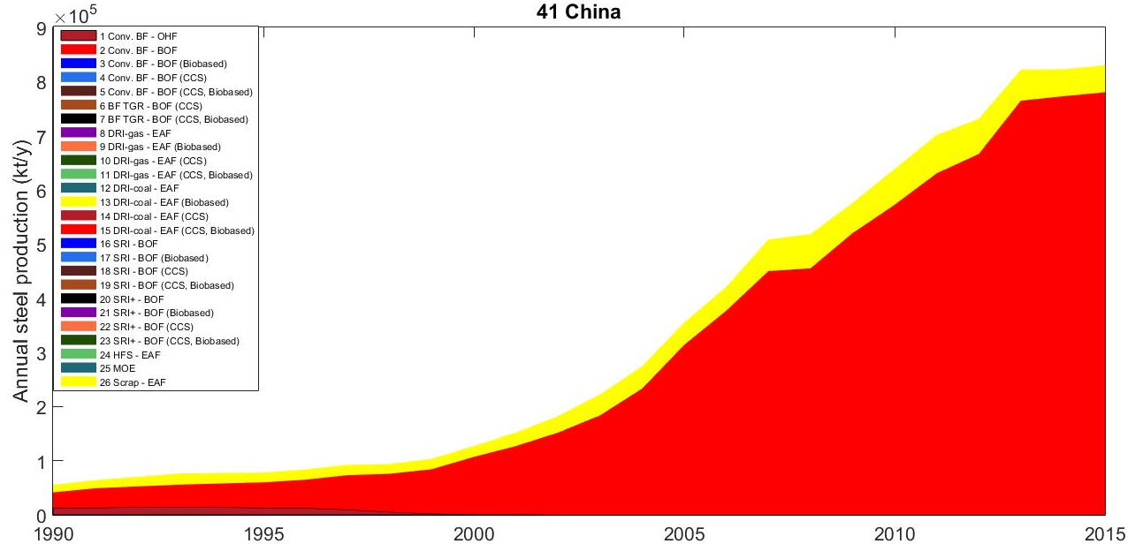
FTT:Steel – China – Current status

Slide 5
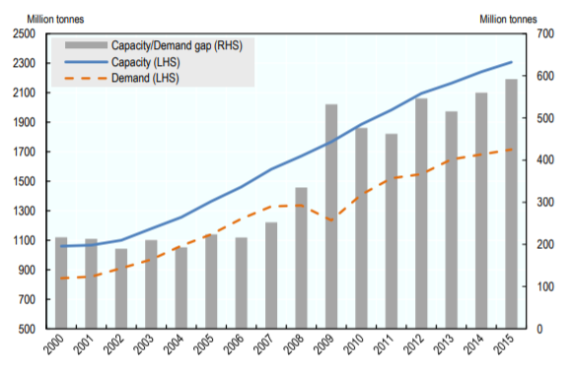
FTT:Steel – China – Challenges
Low scrap availability
Low quality of domestic iron ore and coal
Overcapacity -> Utilisation rates of 50% were reported! (OECD 2015)

Slide 6
FTT:Steel – China – Policies
Nationally Determined Contribution to the Paris Accord:
Reduce emission intensity (GtCO₂/GDP)
This doesn’t mean a reduction in absolute emissions
Reach peak emission before 2030 and reduce afterwards
Increase energy efficiency (GJ/tcs)
Reduce overcapacity
Closing down small (i.e. inefficient) plants to increase the utilisation rate
Merge small to medium steel companies to large ones

Slide 7
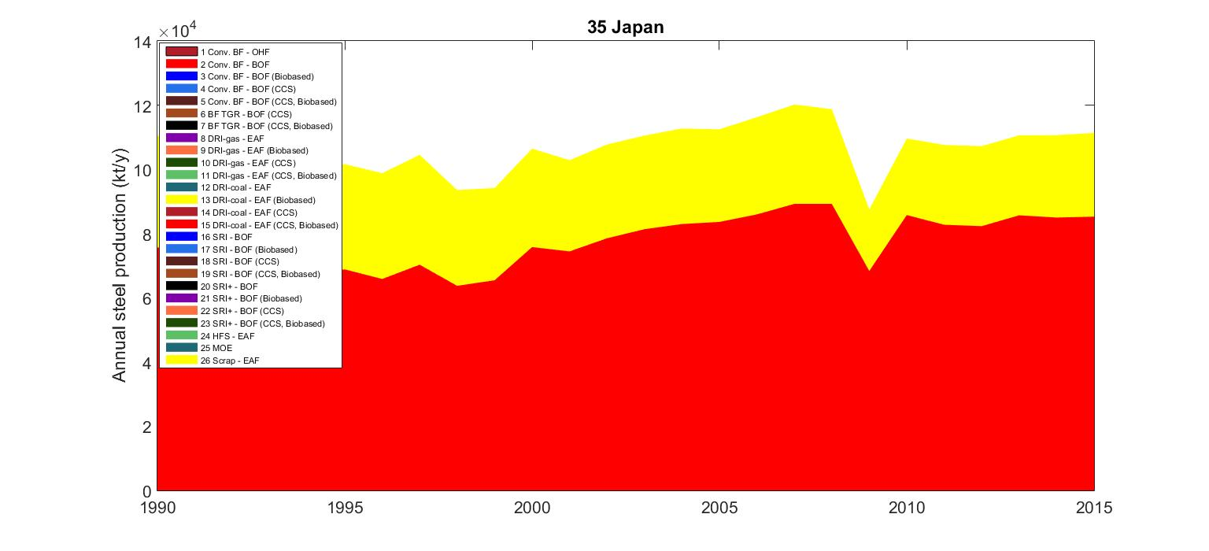
FTT:Steel – Japan – Current status

Slide 8
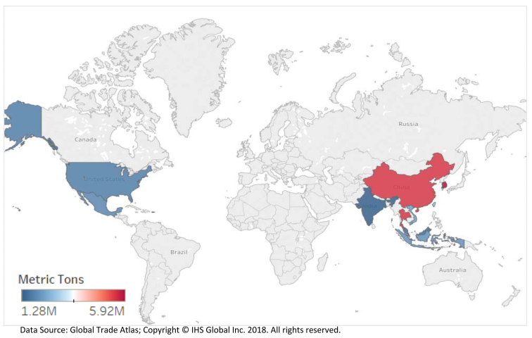
FTT:Steel – Japan – Challenges
Lack of domestic raw materials
Export to the US might become a problem because of steel tariffs
More room for the secondary production routes to grow, probably not enough to become self-reliant though

Slide 9
FTT:Steel – Japan – Policies
NDC target of 26% GHG emission reduction by 2030 compared to 2013
Steel sector specifically addressed:
Efficiency improvement of electricity-consuming facilities
More chemical recycling of waste plastic at steel plants
Introduction of next-generation coke making
Improvement of power generation efficiency process (SCOPE21)
Enhanced energy efficiency and conservation facilities
Introduction of innovative ironmaking process (Ferro Coke)
Introduction of environmentally harmonized steelmaking process (COURSE50)
COURSE50
Voluntary action taken by the steel industry to focus on new, low-carbon technologies
GHG emission reduction target of 30% by 2050

Slide 10
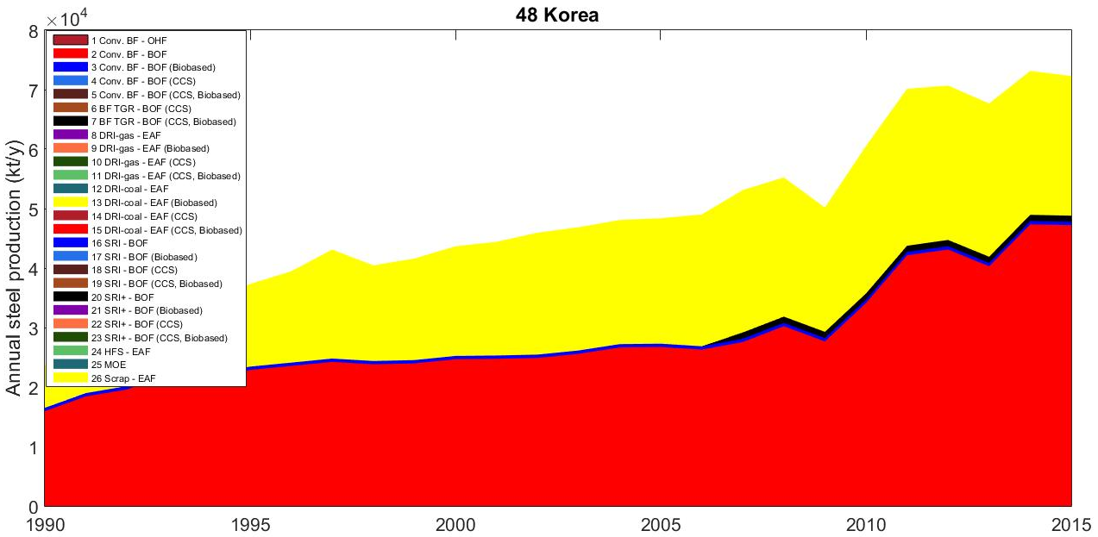
FTT:Steel – Korea – Current status

Slide 11
FTT:Steel – Korea – Challenges
Exempted from US steel tariffs

Slide 12
FTT:Steel – Korea – Policies
GHG emission reduction targets:
30% below BAU by 2020
37% below BAU by 2030.
Emission Trading Scheme
Includes the iron and steel industry

Slide 13
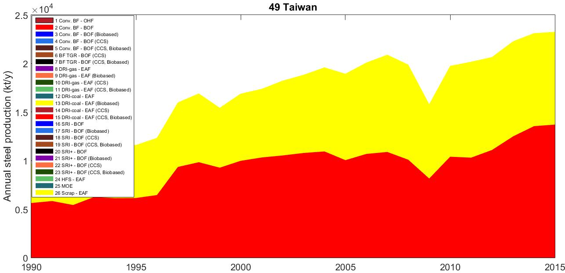
FTT:Steel – Taiwan – Current status

Slide 14
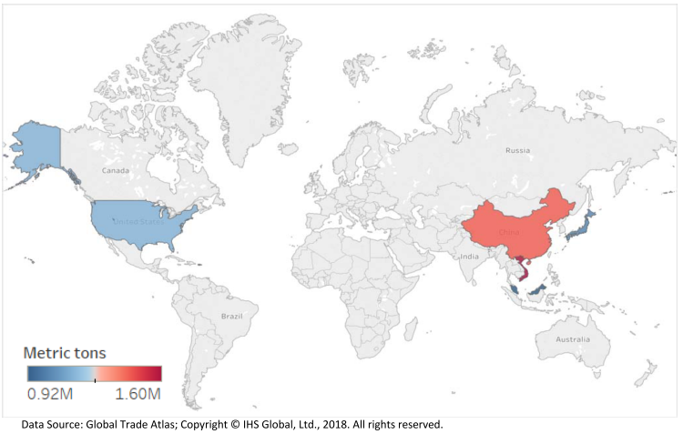
FTT:Steel – Taiwan – Challenges
Relies on import of resources
Taiwan is at risk of being affected by US steel tariffs

Slide 15
FTT:Steel – Taiwan – Policies
No NDC, but a unilateral voluntary contribution
“Greenhouse Gas Reduction and Management Act”
Reduce GHG emissions by 50% compared to BAU in 2050

Slide 16
Data needs
Historical utilisation of technologies is not well reported. Examples:
In Korea FINEX is used (designated as a SRI+ - BOF route), but no timeline of steel production by this technology can be found.
The same for COREX (designated as SRI-BOF) in Korea and China.
And Hismelt (designated as SRI-BOF) in China
Accurate data on anything that could affect the levelised cost of steelmaking:
Regional specific investment costs
Operation and maintenance
But most importantly, material consumption

Slide 17
FTT:Power – Policy setting examples
Now back to policy setting with FTT:Power

Slide 18
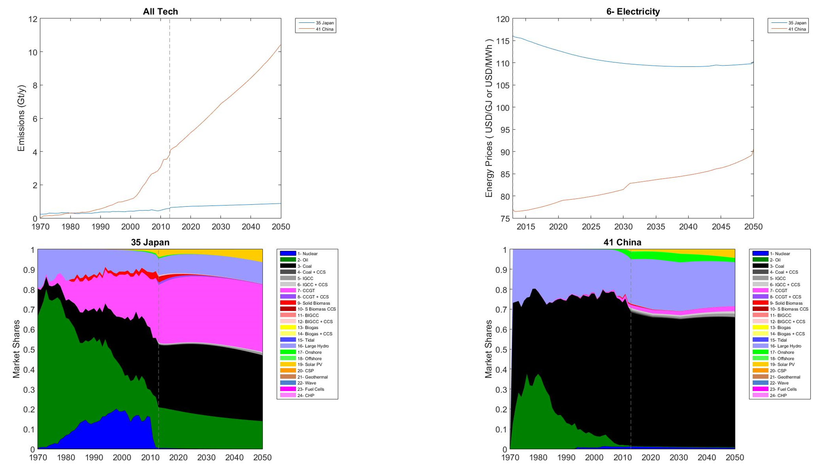
FTT:Power – Recap of last week – Baseline Results

Slide 19
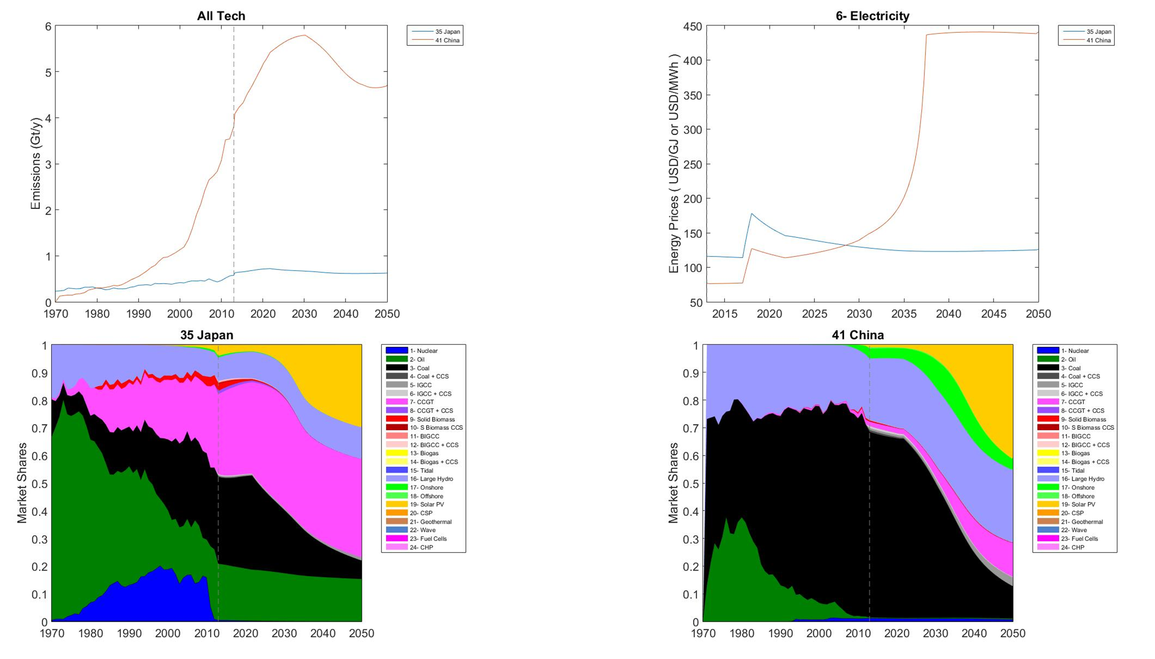
FTT:Power – Recap of last week – S1 Results

Slide 20
FTT:Power – S2– Subsidy + Demand
Scope : Japan (No. 35) and China (No. 41)
Goal : Incentivize renewables (…and cheat a little bit)
Policies
Subsidies on investment costs:
75% for all solar and wind technologies (enter: -0,75)
Electricity storage to capacity ratio (MEES and MEKS):
Japan: 1% in 2018. Let it increase by 2% annually until 50% is reached
China: 30% in 2018. Let it increase by 0,25% annually
Evaluate Emissions, Electricity Price, Market shares of Coal and Renewables (solar and wind), and Total Installed Capacity
Realize that changes occur due to technological diffusion which are driven by the LCOE

Slide 21
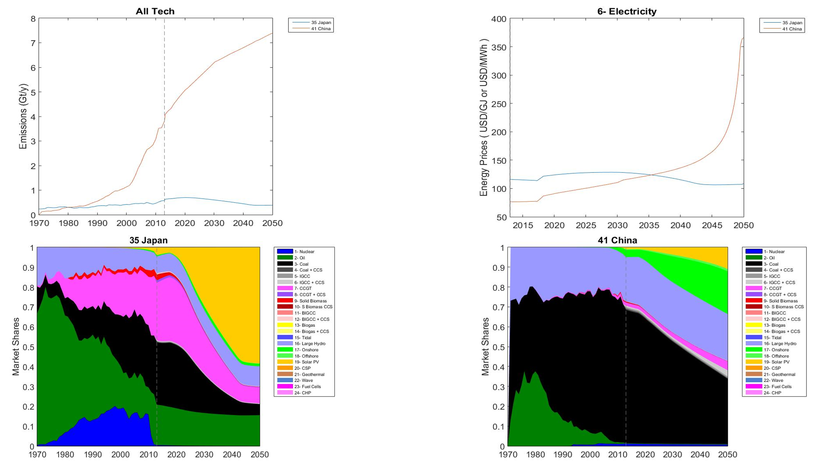
FTT:Power – S2– Subsidy + Demand – Results

Slide 22
FTT:Power – S3– Capacity additions + Regulations
Scope : Japan (No. 35) and China (No. 41)
Goal : Substitute Coal for its CCS variant
Policies
Regulations:
Coal:
Japan: 85 GW in 2018 and a 2,5 GW annual decrease
China: 750 GW in 2018 and a 20 GW annual decrease
MWKA:
Coal (CCS):
Japan: 5 GW in 2018 and a 3,75 GW annual increase
China: 40 GW in 2018 and a 30 GW annual increase
Evaluate Emissions, Electricity Price, Market shares of Coal and Renewables (solar and wind), and Total Installed Capacity
Realize that changes occur due to technological diffusion which are driven by the LCOE

Slide 23
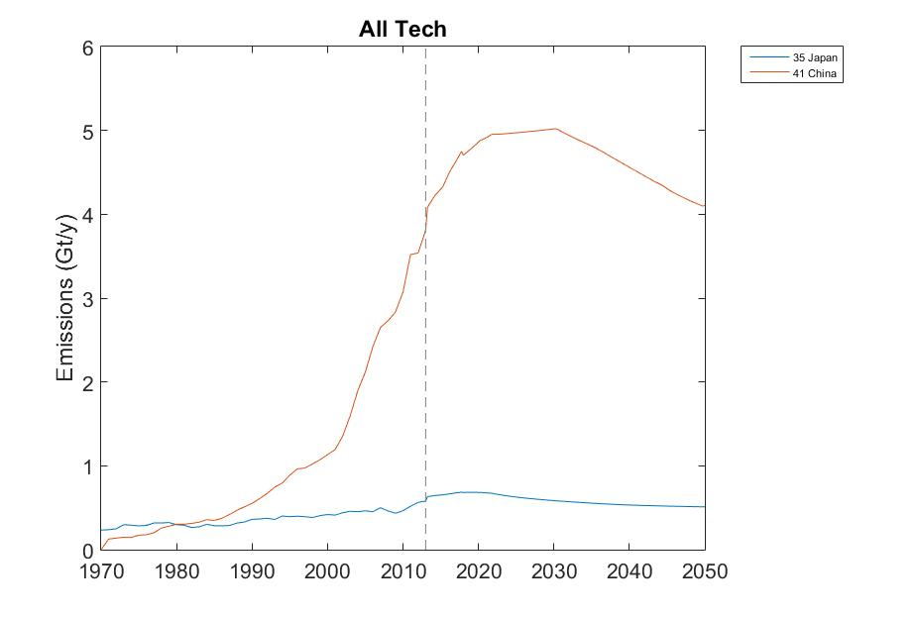
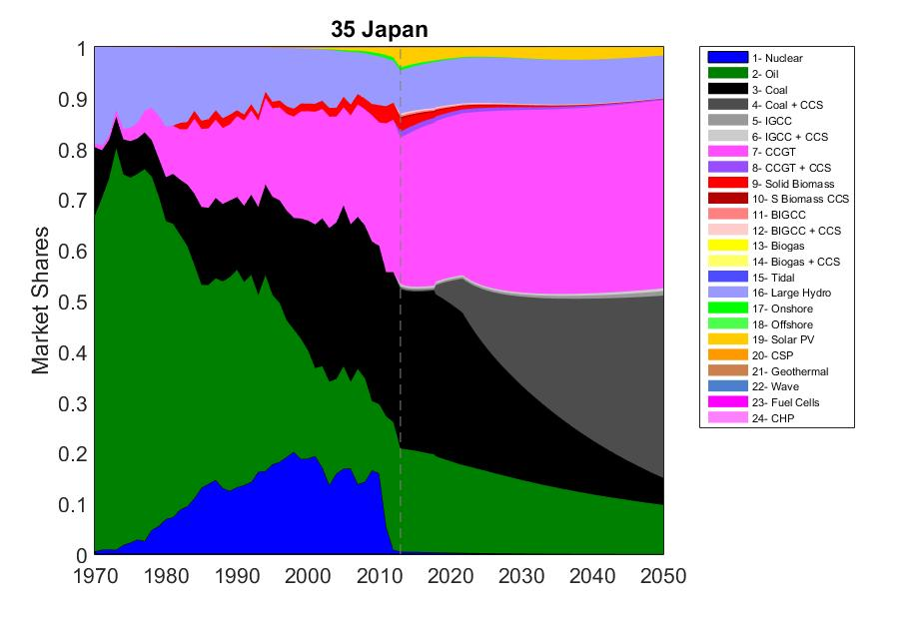
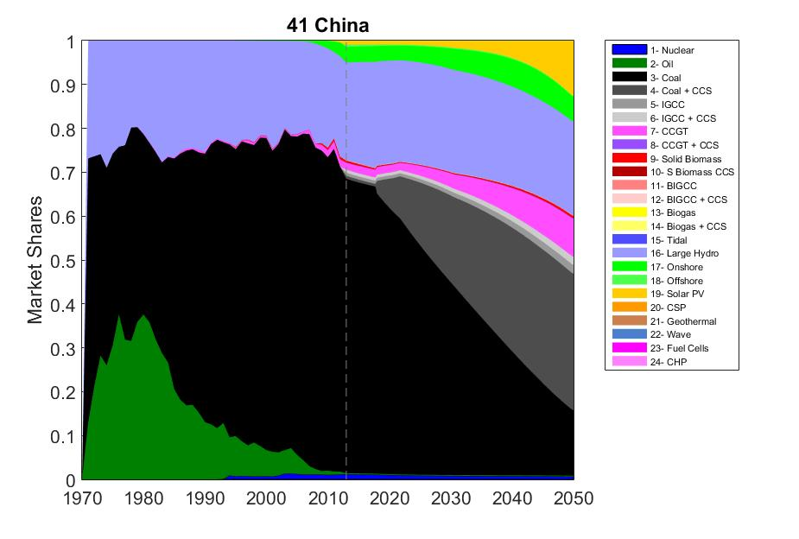
FTT:Power – S3– Capacity additions + Regulations – Results

Slide 24
FTT:Power – S4– Carbon Tax + Feed-in-Tariff
Scope : Japan (No. 35) and China (No. 41)
Goal : Incentivize renewables
Policies
Carbon tax:
For both China and Japan: 55 €/tC in 2018 and increase by 6.5% annually.
Feed-in-Tariff
Solar: From 2018 onwards enter 75 for all solar technologies
Wind: From 2018 onwards enter 75 for all wind technologies
Evaluate Emissions, Electricity Price, Market shares of Coal and Renewables (solar and wind), and Total Installed Capacity
Realize that changes occur due to technological diffusion which are driven by the LCOE

Slide 25
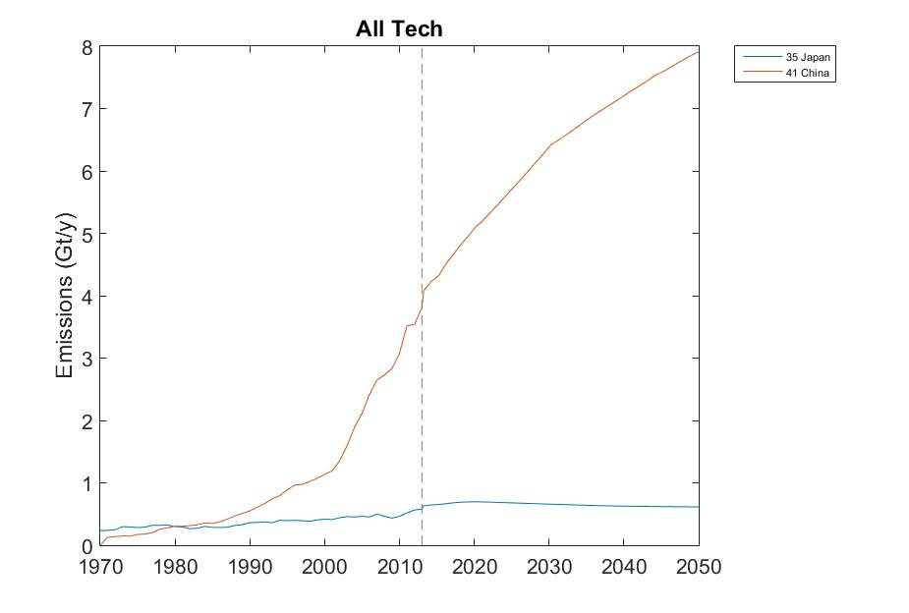
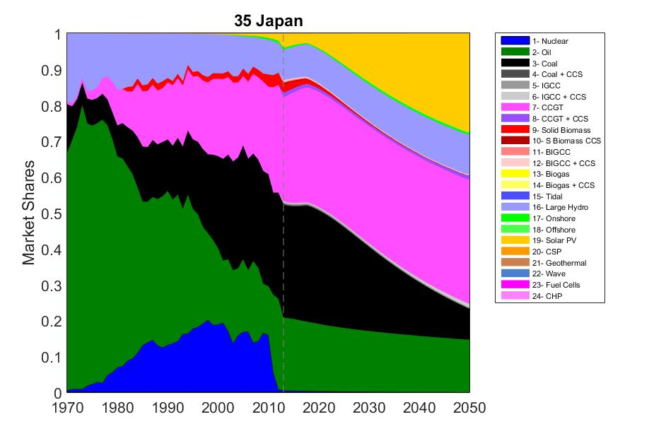
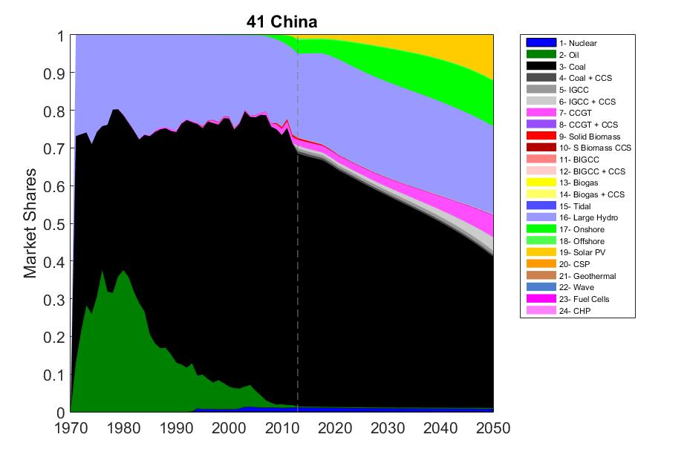
FTT:Power – S4– Carbon Tax + Feed-in-Tariff – Results

Slide 26
FTT:Power – Overview of results
 |  | Japan |  |  |  |  |  | China
 |  | S0 |  | S1 | S2 | S3 | S4 | S0 |  | S1 | S2 | S3 | S4
 |  | 2018 | 2050 | 2050 | 2050 | 2050 | 2050 | 2018 | 2050 | 2050 | 2050 | 2050 | 2050
Emissions | Gt/yr | 0,686 | 0,876 | 0,627 | 0,391 | 0,510 | 0,616 | 4,792 | 10,42 | 4,704 | 7,383 | 4,107 | 7,903
Electricity price | $₁₃ / MWh | 113,7 | 110,3 | 126 | 108,7 | 103,7 | 144,1 | 77,74 | 90,5 | 438,2 | 366,3 | 115 | 241,5
Share of renewables | % | 2,8% | 6,2 | 29,2 | 59,9 | 1,6 | 28,2 | 4,8% | 6,5 | 44,8 | 33,3 | 18,3 | 24
Share of Coal | % | 32,5% | 32,7 | 6,7 | 5,5 | 5,3 | 8,6 | 65,4% | 64,8 | 11,7 | 32,8 | 14,9 | 40,2
Total installed capacity | GW | 270,5 | 350,7 | 380,7 | 757,1 | 347,5 | 381,2 | 1407 | 3026 | 4239 | 4080 | 3232 | 3501

Slide 27
FTT:Power – Overview of results
S0: Baseline
S1: Regulations on Coal in combination with taxes on technologies that might replace it
S2: Subsidies on renewables and an increase in storage capacity
S3: Regulations on Coal mitigated by exogenous capacity additions on Coal + CSS
S4: Carbon tax in combination with Feed-in-Tariffs on renewables
Japan
Best scenario might be S2 for Japan, while it doesn’t work that well for China
China
Best scenario might be S3 for China, which also works for Japan to some degree

